Slide 1
Design and Control of a
Home Delivery Logistics Network
Michael G. Kay
North Carolina State University

Slide 2
Goal of Research
To eliminate the need for all non-recreational shopping by making it possible to have a hot pizza and a vehicle-load of other stuff delivered to your home, exactly when you want, for the price of what you would have tipped the pizza delivery guy.

Slide 3
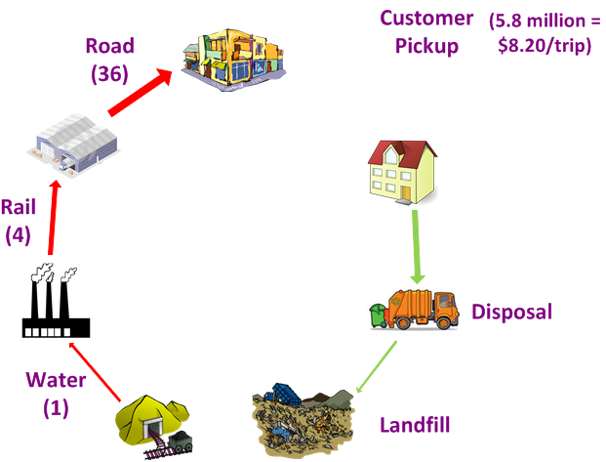



Dirt-to-Dirt Logistics Costs
($/ton-mi relative to water)

Slide 4
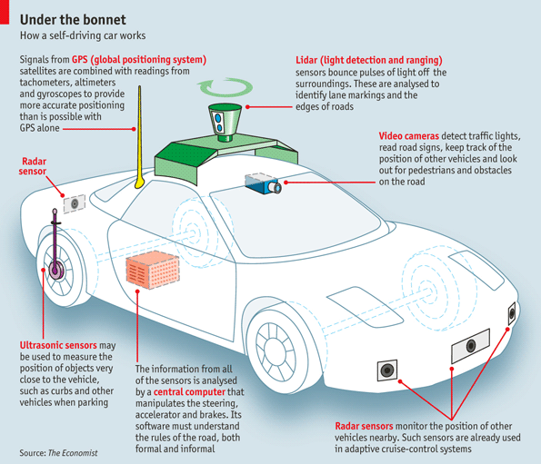
Economics of Driverless Vehicles
Average cost (wage + benefits) of FedEx driver (UPS = $45/hr) = $27/hr x 2000 hr/yr = $54,000 per year
Max investment =
Notes:
Driver costs: http://www.teamster.org/sites/teamster.org/files/nl_UPSTeamster_Jan_2011.pdf
Max investment: real interest rate of 1.7% and economic life of 5 years with no salvage value
Image: http://www.economist.com/node/21560989

Slide 5
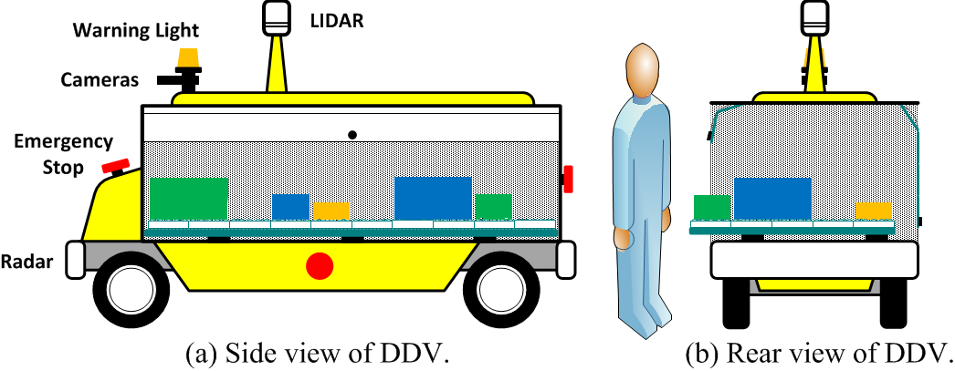
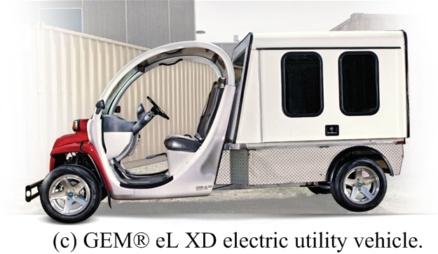
Driverless Delivery Vehicle

Slide 6
Home Delivery Logistics Network

Slide 7
Automated Loading/Unloading

Slide 8
Module and Container Design

Slide 9
Container Accessibility

Slide 10
DC (top view of one level)

Slide 11
DC (side view)

Slide 12
Current Research Areas
Storage System Control
  Unload, store, and load each container in a DC (joint work with Peerapol Sittivijan)
Module Design
  Design module prototype to estimate cost vs transit-time tradeoff
Network Coordination
  Develop mechanism to coordinate the operation of each container, vehicle, and DC in the network
Performance Analysis
  Estimate delivery times and associated cost for given logistic network

Slide 13
Area 1: Storage System Control

Slide 14
Path Planning and Execution
Module ≤ Container ≤ Shipment ≤ Load
3-D (x,y,t) A* used for planning path of each container
Each container assigned unique priority that determines planning sequence
  Paths of higher-priority containers become obstacles for subsequent containers
  First-in-last-out loading/unloading → must change container priority from when it is unloaded to when it is loaded
Adaptive priority adjustment to correct for:
  Delay along planned path
  Deadlock detection
Destination of containers in long-term storage is maxmin distance to other containers

Slide 15
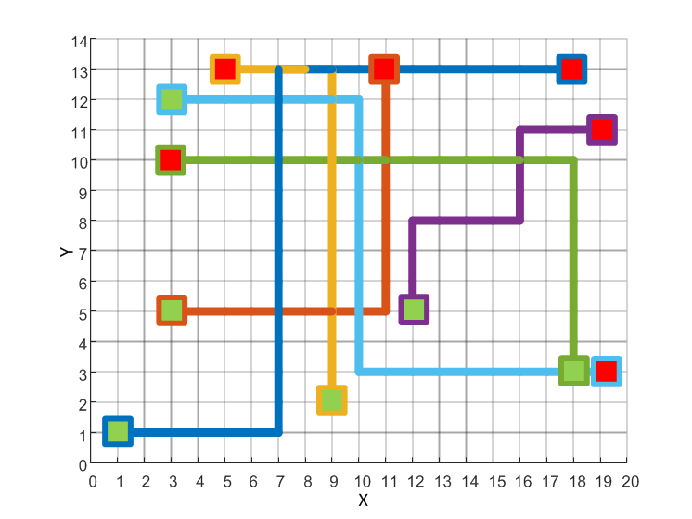
2-D Paths

Slide 16
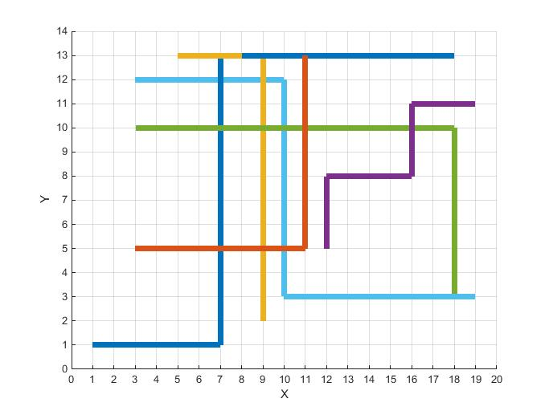
2-D Paths

Slide 17
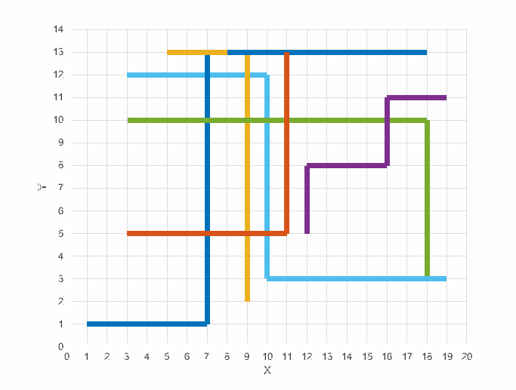
3-D Paths

Slide 18
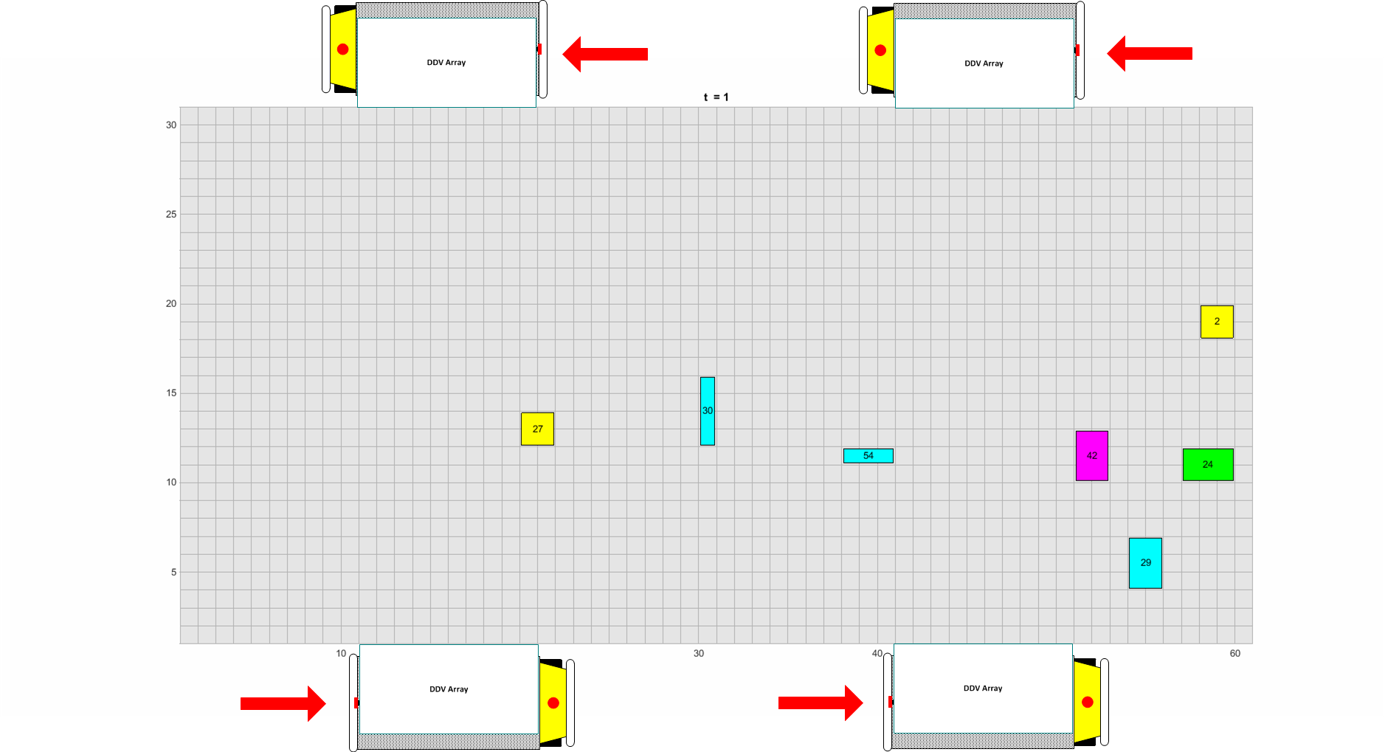
Example: Loads on DDVs Arrive to DC

Slide 19
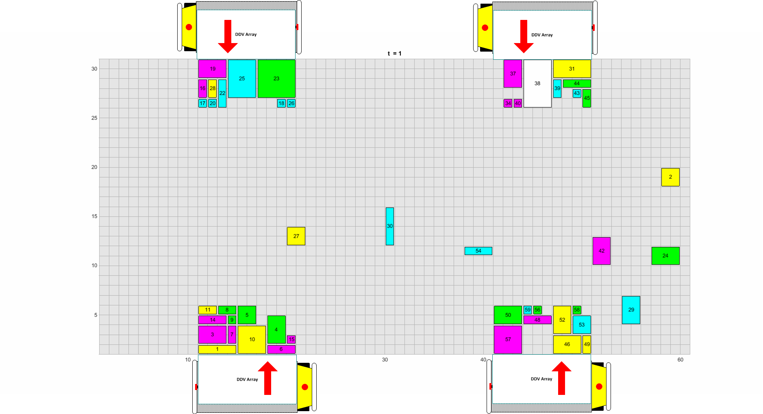
Example: Loads Unloaded into DC

Slide 20
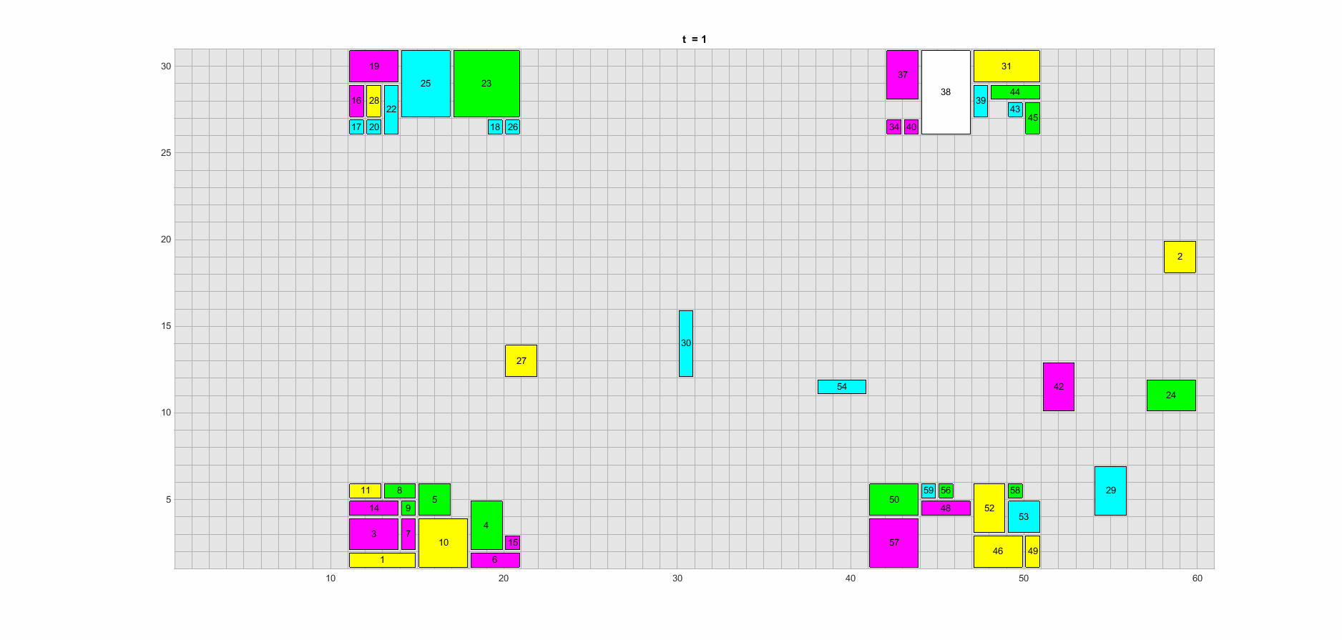
Example: Containers Move to Staging

Slide 21
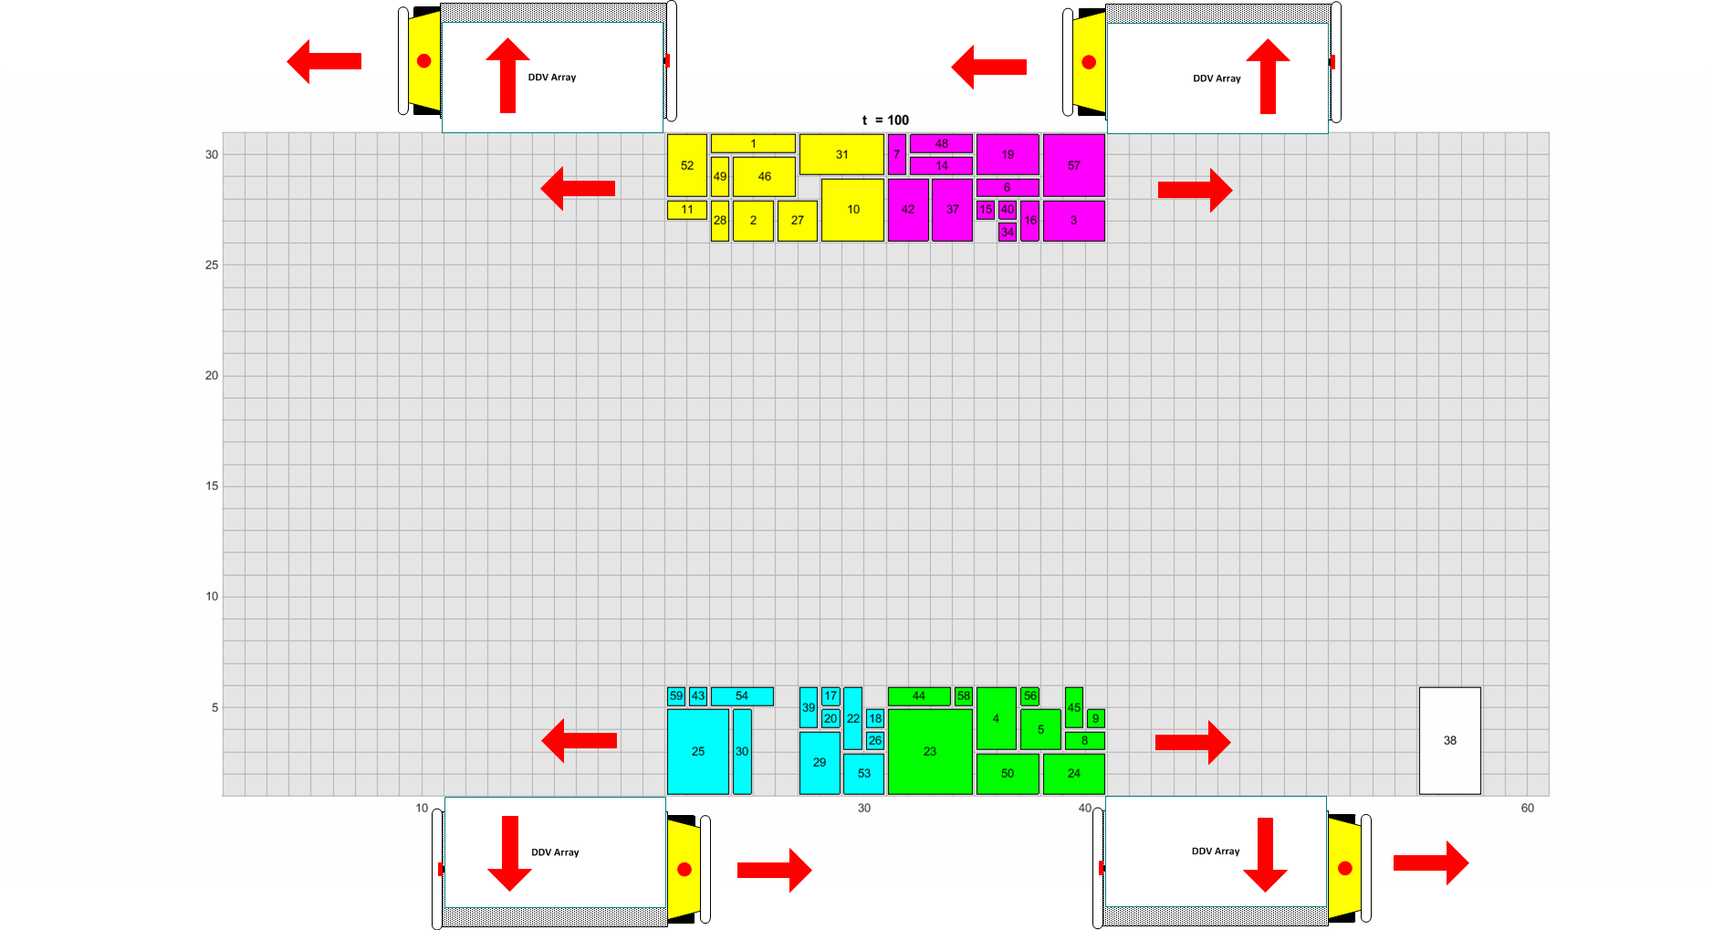
Example: Containers Loaded on DDVs

Slide 22
Area 2: Module Design
Develop prototype modules and containers to determine performance vs cost tradeoff
  Container transit time (target 5 sec)
  Module cost (target $50-$100 at scale)
Economies of scale: 2.5 billion modules in 100,000 DCs covering U.S.

Slide 23
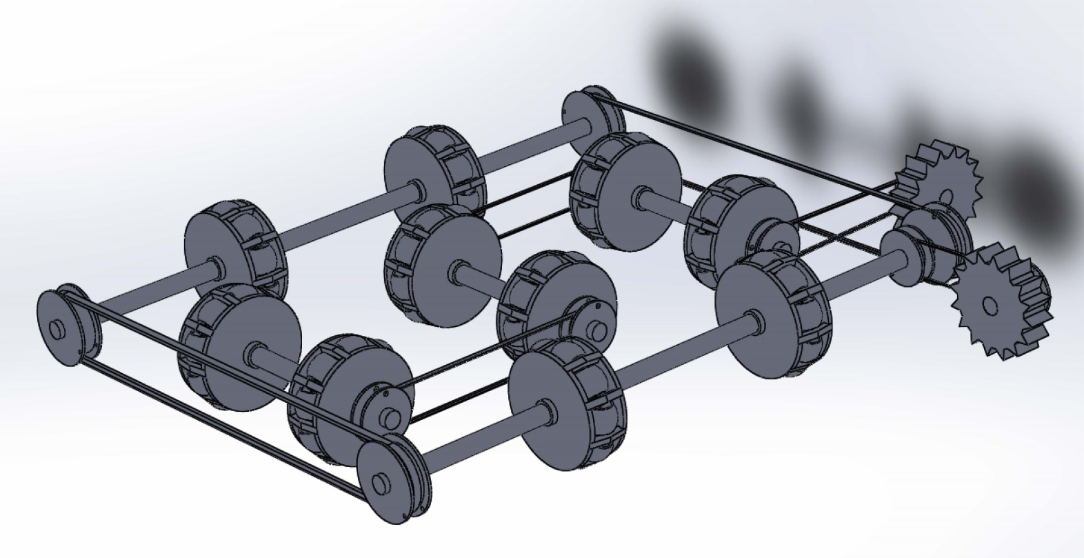
Prototype Module
Mix of off-the-shelf and custom components
3D printing/additive manufacturing to be used to prototype custom components and housing

Slide 24
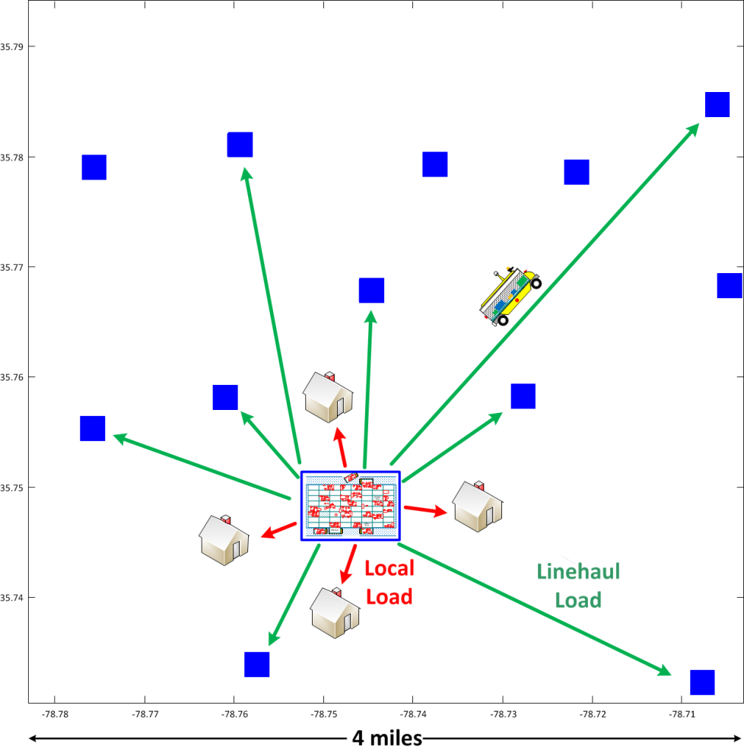
Area 3: Network Coordination
Separate firm can own each DC and DDV → coordination more difficult than private network
Local load is a single shipment
Containers in linehaul load part of different shipments each owned by a separate firms
Containers pay DC for storage time

Slide 25

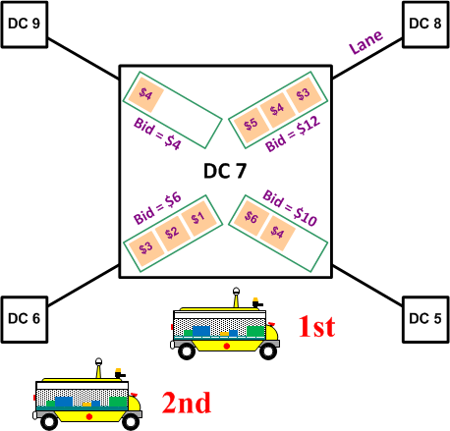
Load Bids
Load bid is sum of container bids in load
Loads in a lane ordered by decreasing bid
  Containers bid for services of the DDVs used for their transport
  Containers going to same DC compete to be in next transported load
  Loads to different DCs competing to be selected by a DDV
  DDVs competing with each other to select loads
Single (1-D) Load
Multiple Loads at DC

Slide 26
DDV Protocol
Determines which DDV is used to transport what load at what DC
Goal for DDV operation:
  Try to match the load that values transport the highest with the DDV that can provide that transport service at the least cost
Protocol:
  Priority for Accepting Loads: Opportunity to accept or reject load based on DDV’s expected arrival time at DC
  Reneging: After reneging, DDV cannot again accept same load until all other DDVs have rejected it

Slide 27
1. Priority for Accepting Loads
Opportunity to accept or reject load based on DDV’s arrival time at DC
DDV’s portion of load bid fixed after acceptance
If all DDVs reject load, then it’s posted at DC and available for any DDV to accept
Load at DC 7

Slide 28
2. Reneging
After reneging, DDV cannot again accept same load until all other DDVs have rejected it
Near and far DDV accept high and low bids, respectively

Slide 29
2. Reneging
After reneging, DDV cannot again accept same load until all other DDVs have rejected it
Near and far DDVs accept high and low bids, respectively
Low bid now increases beyond high bid

Slide 30
2. Reneging
After reneging, DDV cannot again accept same load until all other DDVs have rejected it
Near and far DDVs accept high and low bids, respectively
Low bid now increases beyond high bid
DDVs agree to renege (since far DDV’s portion fixed at $50)

Slide 31
2. Reneging
After reneging, DDV cannot again accept same load until all other DDVs have rejected it
Near and far DDVs accept high and low bids, respectively
Low bid now increases beyond high bid
DDVs agree to renege (since far DDV’s portion fixed at $50)
Near DDV accepts $200 bid and far DDV $100 bid

Slide 32
Container Protocol
Determines which containers selected to join load
Goal for container selection:
  Encourage a container to submit a bid that represents its true value for transport as soon possible, thereby allowing DDVs to be more responsive and discouraging multiple-bid auction-like behavior
Protocol:
  Load Formation: Bid per unit area of each container used by
  2-D bin-packing heuristic to form loads
  Allocation of Load Bid: After acceptance, DDV’s portion of load bid does not increase and bids of any subsequent containers joining load allocated to original containers
  Withdrawal and Rebidding: Containers that withdraw or rejoin load charged their previous bid amounts in addition to current bid

Slide 33
1. Load Formation
Containers assigned to load that maximizes resulting load bid
Containers can bid as soon as they are at or inbound to DC

Slide 34
2. Allocation of Load Bid
DDV’s portion of load bid fixed after acceptance
Subsequent increases in bid allocated to container in load (and remain in load) at time of acceptance

Slide 35
3. Withdrawal and Rebidding
Containers that withdraw or rejoin load are charged previous bid amounts

Slide 36
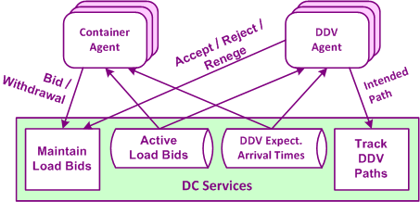
Agent-based Coordination
Each container and each DDV controlled by a software agent
Agents:
  provided with all load bids at DC and all DDV locations
  can make side payments with each other

Slide 37
2-D Load Formation: Select Containers
Containers sorted based on decreasing per-unit bid value
Selected until cumulative area = 50, capacity of module array

Slide 38
2-D Load Formation: Order Containers
Order sequence determined based on:
  Length
  Width
  Bid
Upper Bound (UB) = sum of bids of all containers
May not be feasible to fit (pack) all containers into array (bin)

Slide 39
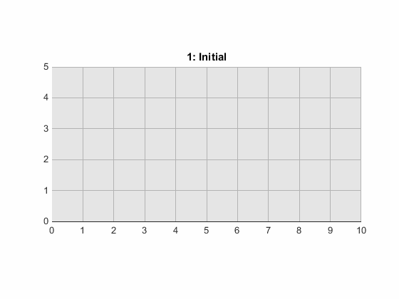
2-D Load Formation: Bin Packing
Initial: Add containers based on order sequence
Re-check: try adding any cont. left out of initial load
Add more efficient: replace if more efficient cont. can be added
Add extras: insert cont. in any available space
Final

Slide 40
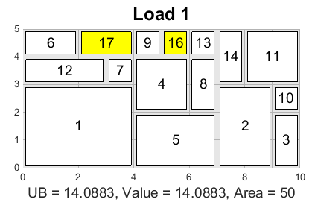
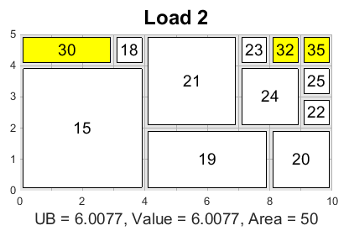
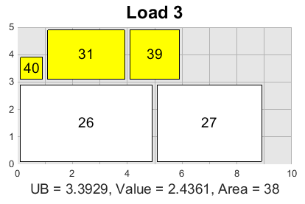
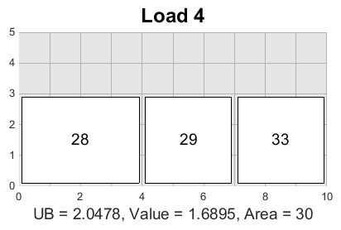
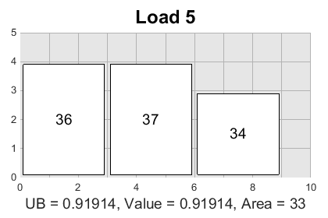
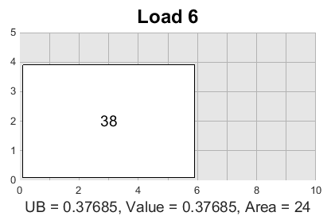
Diseconomies of Scale
Yellow containers spend/bid less on a per-unit basis to join a load leaving earlier due to their smaller size
(Containers 1-40 numbered in decreasing total bid; Loads 1-6 in increasing departure time)

Slide 41
Area 4: Performance Analysis
Home Delivery Cost Estimate

Slide 42
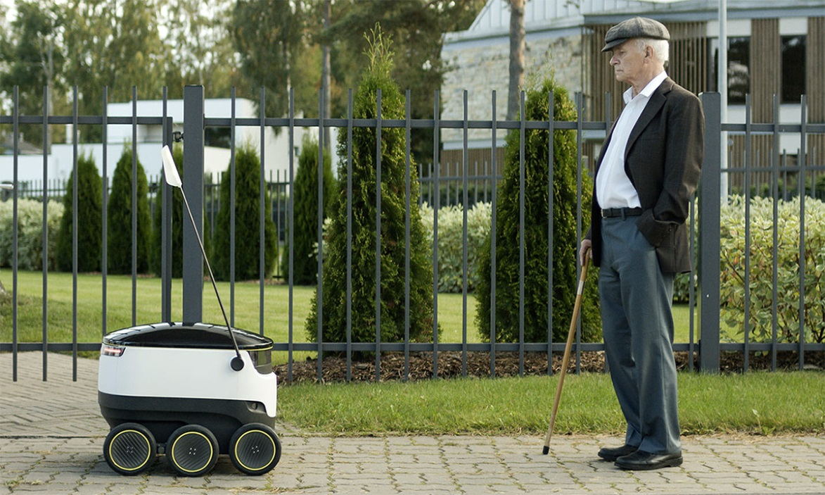
Available 2016: Starship Technologies
Started by Skype co-founders
99% autonomous (human operators are available to take control)
Goal: “deliver ‘two grocery bags’ worth of goods (weighing up to 20lbs) in 5-30 minutes for ‘10-15 times less than the cost of current last-mile delivery alternatives.’”
http://www.engadget.com/2015/11/02/starship-technologies-local-delivery-robot/
Notes:
http://www.engadget.com/2015/11/02/starship-technologies-local-delivery-robot/
Image:http://o.aolcdn.com/hss/storage/midas/ceec8143fcb040f70150b764c8702308/202903595/starship.jpg

