Slide 1
Public Logistics Networks
Michael G. Kay
North Carolina State University
Raleigh, NC, USA

Slide 2
Public vs Private Logistics Networks
Public Network | Private Network
Each vehicle and facility can be operated by different firm | Single firm (UPS, Amazon) coordinates network, owning all critical resources
Each vehicle/facility has access to potentially all of network’s demand ⇒ scale economies and dense network | Each vehicle/facility has access to only single firm’s portion of demand ⇒ sparse network
Decentralized control via open standards and coordination protocols ⇒ low barrier to entry | Centralized control via firm-specific proprietary standards and coordination procedures ⇒ high barrier to entry
High degree of public facilities for ocean and air logistics
Mix of public/private networks for rail
Few public networks for intercity trucking and urban logistics
  Public terminals on outskirts of cities in Japan used to consolidate deliveries to stores in congested city centers

Slide 3
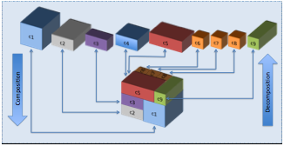
Logistics vs Computer Networks
Public Logistics Network | Internet
Packages transported | Packets transmitted
Distribution centers (DCs) | Routers
Vehicles | Wire, fiber
Slow speed allows node/DC based control | Edge-control due high node throughput
Physical Internet Initiative:
  Benoit Montreuil, Eric Ballot
  Open global logistics system based on physical, digital, and operational interconnectivity
  Encapsulation, interfaces and protocols
  π-containers provide standard for interoperability

Slide 4
Research
Goal:
  Provide tools for expanded role of public logistics networks in intercity trucking and urban logistics
Approach:
  Develop open distributed coordination mechanism that
    Achieves same operational efficiencies as single integrated private network
    Can lower cost through scale economies of serving all demand
      Something only monopoly-private or government-run networks can currently do
Main Tool:
  Algorithmic Mechanism Design

Slide 5
Basic Mechanism for Public Networks
Mechanism determines:
  Which shipments form a load
  How cost paid to carrier (vehicle) to transport load is allocated to shipments
Mechanism tries to match shipments that value transport the highest with vehicles that can provide it at least cost:
  Shipment(s) bid for transport (reverse of Uber)
  Strong incentives for early bidding
  Public data + Computationally efficient online protocols →
    Shipments can determine their exact cost prior to bidding
    Most processing is planning done locally by shipments/vehicles

Slide 6
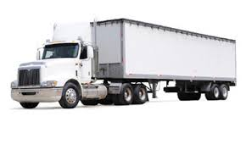


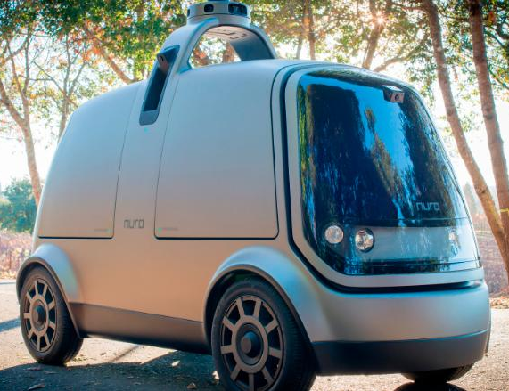
Two Examples
Intercity Trucking:
  Mechanism used to create
  consolidated multi-stop truckloads
  Alternative to current 3PL and TL/LTL carriers
Home delivery:
  Mechanism used to coordinate network of modular distribution centers and driverless delivery vehicles
Amazon Drone
Starship
Delivery Robot
Nuro
Delivery Vehicle
Delivery Vehicle with
Auto Unloading

Slide 7
Example 1: Intercity Trucking

Slide 8
Intercity Trucking Operations
Truckload (TL) routing alternatives
Logistics network used for less-than-truckload (LTL)

Slide 9
Coordination Mechanism
Public information posted for each shipment
  Size/weight
  Density
  Distance (based on origin/destination)
Load formed by first shipment
  Sets anchor transport rate
  Sets its earliest pickup and latest delivery times
Subsequent shipments that join load
  Determine their cost using standard transport charge and online routing heuristic
  Can veto later shipments wanting to join
Route created using order shipments join load
Shipments can join/leave multiple loads until load scheduled

Slide 10
Coordination Mechanism

Slide 11
Standard Transport Charge
Charge based on
  Shipment’s public data
  Anchor TL rate
  Empirical LTL rate estimate

Slide 12
Example: TL + TL Same O/D
Shipment 1
  sets r = 1, d = 300, TL, max c = 300
Shipment 2
  same O/D, TL, max c = 300
300
1
2

Slide 13
Example: TL + LTL Same O/D
Shipment 1
  sets r = 1, d = 300, TL, max c = 300
Shipment 2
  same O/D, LTL, max c = 100
 | 1 | 2
1 2 | 300 | 0
2 1 | 200 | 100
 | 250 | 50
300
1
100
2
(Shapley value allocation)

Slide 14
Example: TL + TL Different O/D
Shipment 1
  sets r = 1, d = 300, TL, max c = 300
Shipment 2
  different O/D, TL, max c = 250
 | 1 | 2
1 2 | 300 | 10
2 1 | 60 | 250
 | 180 | 130
310
1
2

Slide 15
Multi-Stop Routing
Each shipment might have a different origin and/or destination ⇒ node/location sequence not adequate

Slide 16
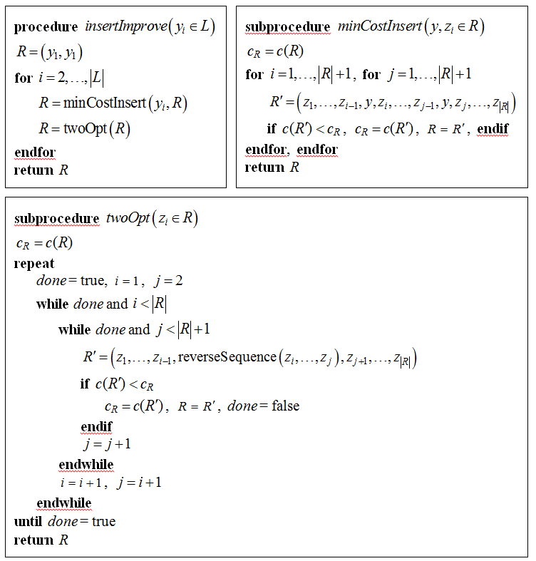
Online Routing Heuristic
To route each shipment added to load:
  Minimum Cost Insertion
  Two-opt improvement
Different shipment sequences can result in different routes
  Order shipment joins load important

Slide 17
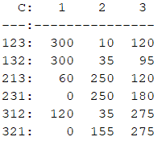
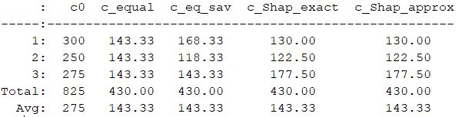
Shapley Value Approximation
Shapley value
  Average additional cost shipment imposes by joining route
  Exact value requires n!
  Use n² pairwise savings approximation instead

Slide 18
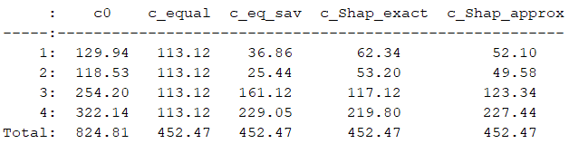
Intercity Trucking Example
4 out 30 available shipments form consolidated load
  Savings of 824.81 – 452.47 = 372.34 from consolidation
  Pairwise approximation differs from exact Shapley value

Slide 19
Example 2: Home Delivery

Slide 20
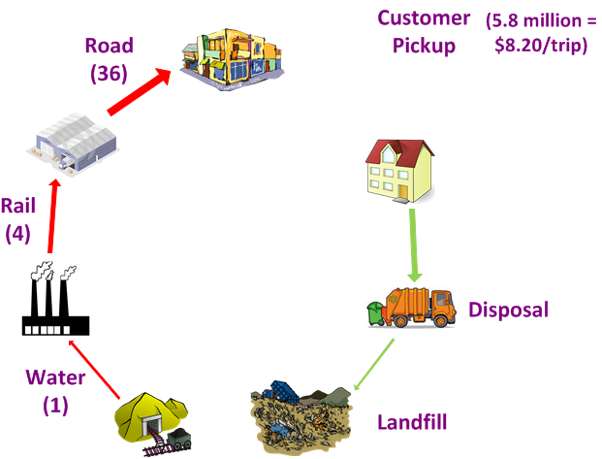



Dirt-to-Dirt Logistics Costs
($/ton-mi relative to water)

Slide 21
Home Delivery Logistics Network

Slide 22
DC (side view)

Slide 23
DC (top view of one level)

Slide 24
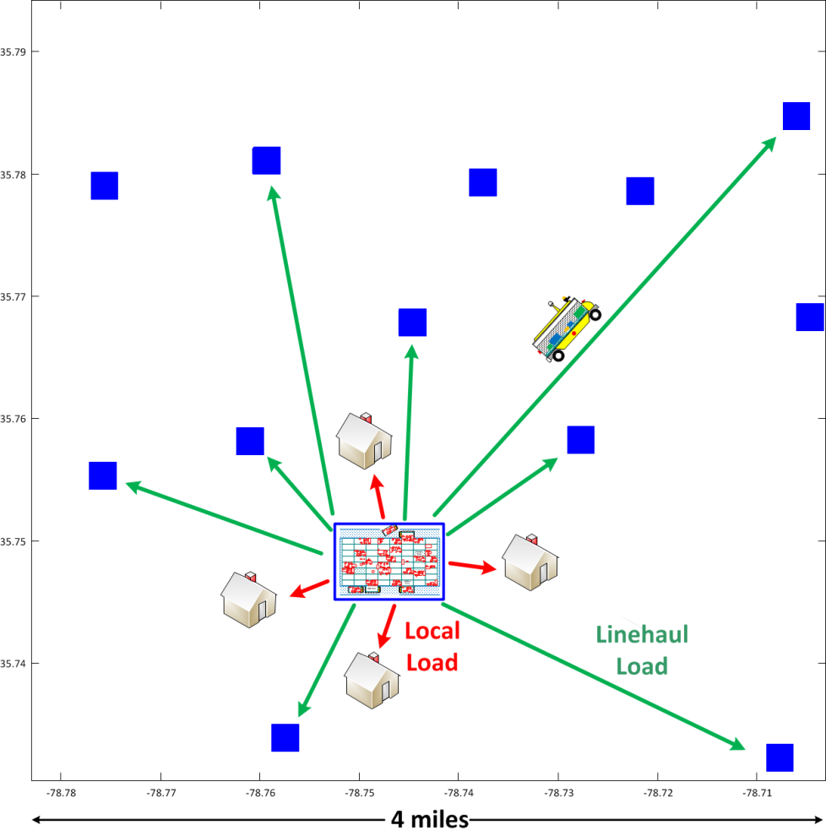
Coordination Mechanism
Separate firm can own each DC and DDV → coordination more difficult than private network
Local load is a single shipment
Containers in linehaul load part of different shipments each owned by a separate firms
Containers pay DC for storage time

Slide 25

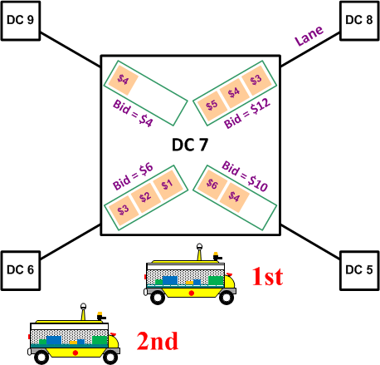
Load Bids
Load bid is sum of container bids in load
Loads in a lane ordered by decreasing bid
  Containers bid for services of the DDVs used for their transport
  Containers going to same DC compete to be in next transported load
  Loads to different DCs competing to be selected by a DDV
  DDVs competing with each other to select loads
Single 1-D Load
(actual load 2-D)
Multiple Loads at DC

Slide 26
DDV Protocol
Determines which DDV is used to transport what load at what DC
Goal for DDV operation:
  Try to match the load that values transport the highest with the DDV that can provide that transport service at the least cost
Protocol:
  Priority for Accepting Loads: Opportunity to accept or reject load based on DDV’s expected arrival time at DC
  Reneging: After reneging, DDV cannot again accept same load until all other DDVs have rejected it

Slide 27
1. Priority for Accepting Loads
Opportunity to accept or reject load based on DDV’s arrival time at DC
DDV’s portion of load bid fixed after acceptance
If all DDVs reject load, then it’s posted at DC and available for any DDV to accept
Load at DC 7

Slide 28
2. Reneging
After reneging, DDV cannot again accept same load until all other DDVs have rejected it
Near and far DDV accept high and low bids, respectively

Slide 29
2. Reneging
After reneging, DDV cannot again accept same load until all other DDVs have rejected it
Near and far DDVs accept high and low bids, respectively
Low bid now increases beyond high bid

Slide 30
2. Reneging
After reneging, DDV cannot again accept same load until all other DDVs have rejected it
Near and far DDVs accept high and low bids, respectively
Low bid now increases beyond high bid
DDVs agree to renege (since far DDV’s portion fixed at $50)

Slide 31
2. Reneging
After reneging, DDV cannot again accept same load until all other DDVs have rejected it
Near and far DDVs accept high and low bids, respectively
Low bid now increases beyond high bid
DDVs agree to renege (since far DDV’s portion fixed at $50)
Near DDV accepts $200 bid and far DDV $100 bid

Slide 32
Container Protocol
Determines which containers selected to join load
Goal for container selection:
  Encourage a container to submit a bid that represents its true value for transport as soon possible, thereby allowing DDVs to be more responsive and discouraging multiple-bid auction-like behavior
Protocol:
  Load Formation: Bid per unit area of each container used by
  2-D bin-packing heuristic to form loads
  Allocation of Load Bid: After acceptance, DDV’s portion of load bid does not increase and bids of any subsequent containers joining load allocated to original containers
  Withdrawal and Rebidding: Containers that withdraw or rejoin load charged their previous bid amounts in addition to current bid

Slide 33
1. Load Formation
Containers assigned to load that maximizes resulting load bid
Containers can bid as soon as they are at or inbound to DC

Slide 34
2. Allocation of Load Bid
DDV’s portion of load bid fixed after acceptance
Subsequent increases in bid allocated to container in load (and remain in load) at time of acceptance

Slide 35
3. Withdrawal and Rebidding
Containers that withdraw or rejoin load are charged previous bid amounts

Slide 36
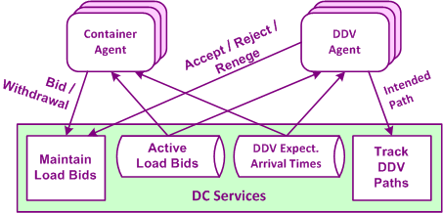
Agent-based Coordination
Each container and each DDV controlled by a software agent
Agents:
  provided with all load bids at DC and all DDV locations
  can make side payments with each other

Slide 37
Bid Interval

Slide 38
Bid Intervals
Each container and each DDV controlled by a software agent
Agents:
  provided with all load bids at DC and all DDV locations
  can make side payments with each other

Slide 39
2-D Load Formation
Arrays of 50 modules
  Used on DDV
  Used in DC
Enables automatic loading/unloading
Container on a module

Slide 40
2-D Load Formation: Select Containers
Containers sorted based on decreasing per-unit bid value
Selected until cumulative area = 50, capacity of module array

Slide 41
2-D Load Formation: Order Containers
Order sequence determined based on:
  Length
  Width
  Bid
Upper Bound (UB) = sum of bids of all containers
May not be feasible to fit (pack) all containers into array (bin)

Slide 42
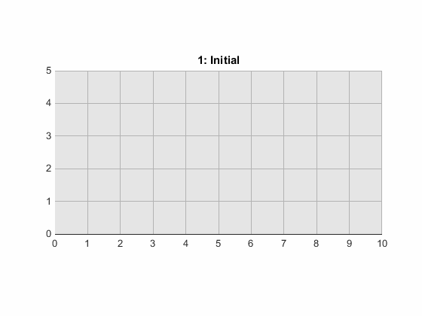
2-D Load Formation: Bin Packing
Initial: Add containers based on order sequence
Re-check: try adding any cont. left out of initial load
Add more efficient: replace if cont. with higher per-unit bid can be added
Add extras: insert cont. in any available space
Final

Slide 43
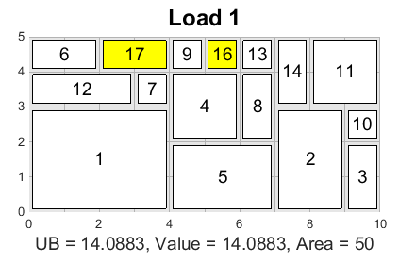
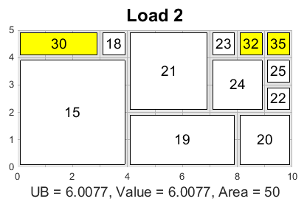
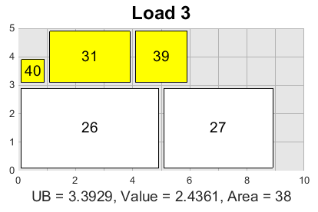
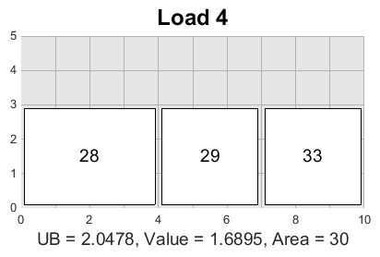
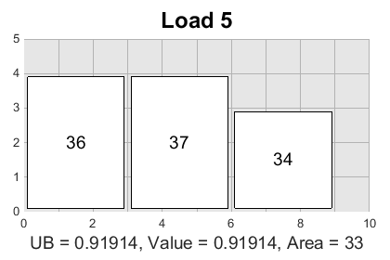
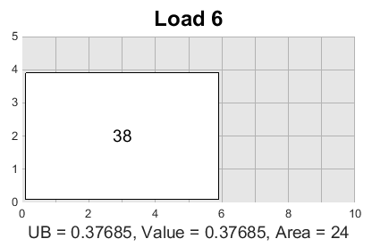
Diseconomies of Scale
Yellow containers spend/bid less on a per-unit basis to join a load that is leaving earlier due to their smaller size
(Containers 1-40 numbered in decreasing total bid; Loads 1-6 in increasing departure time)

Slide 44
Comparison
Intercity Trucking | Home Delivery
Separate firms own trucks, shipments | Separate firms own DDVs, containers, DCs
Multi-stop: different O/D each shipment | Point-to-point: DC-DC, DC-home
First shipment sets rate for load | Each container sets own bid
Can drop out of load without penalty until truck accepts | Can withdraw at any time with penalty (after DDV accepts, subsequent bids given back to initial containers in load)
Route heuristic, Shapley approximation | 2-D bin packing heuristic
Within protocol: LTL rate option limits small shipment allocated charge | Outside of protocol: Drone delivery limits max bid of time-sensitive containers

